Slide 1
RESTful Services

Slide 2
What is Representational State Transfer?
REST is a way of thinking, not a protocol or standard.
REST is a style of designing loosely coupled Web applications that rely on named resources — in the form of Uniform Resource Locators (URLs), rather than messages (e.g. SOAP).
Based on already validated and successful infrastructure of the Web — HTTP

Slide 3
REST Basics
Concrete implementation of a REST Web service follows four basic design principles.
  Use HTTP methods explicitly
  Be stateless
  Expose directory structure-like URIs.
  Transfer XML, JavaScript Object Notation (JSON), or both.

Slide 4
  Use HTTP methods explicitly
Use HTTP methods in a way that follows the protocol as defined by RFC 2616. For example. GET, POST to read and create resources
REST asks developers to use HTTP methods explicitly and in a way that's consistent with the protocol definition
  To create a resource on the server, use POST.
  To retrieve a resource, use GET.
  To change the state of a resource or to update it, use PUT.
  To remove or delete a resource, use DELETE.

Slide 5
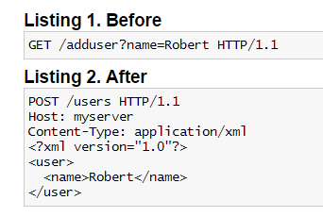
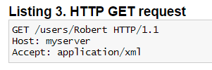
Use HTTP methods explicitly
What is the issue with Listing 1?

Slide 6

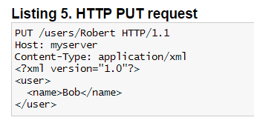
Use HTTP methods explicitly

Slide 7
Be Stateless
REST Web services need to scale to meet increasingly high performance demands. Server side state cost high e.g. sessions. Loads balancing and scaling becomes easy.
Request should carry all data need by server-side component to generate the response in headers or body (or both).

Slide 8
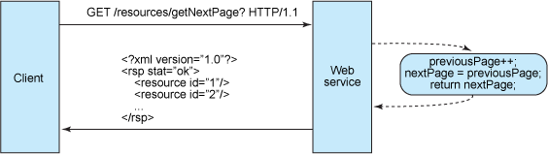
Be Stateless – What happens when statefull?
Assume there is multi page result set.
We need to store previous page at Server to render next page.

Slide 9
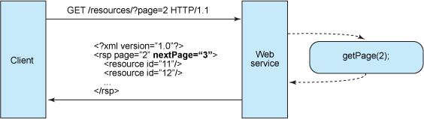
Be Stateless
Stateless server-side components are less complicated to design, write and distribute across load-balanced servers.
Client Application is responsible to maintain the state.
Response may carry link to other related resources and cache control headers.

Slide 10
Expose directory structure-like URIs
REST Web service URIs should be intuitive to the point where they are easy to guess.
Think of a URI as a kind of self-documenting interface that requires little, if any, explanation or reference for a developer to understand what it points to and to derive related resources.
Lets look at some example URIs.
  http://www.myservice.org/discussion/topics/{topic} GET
  http://www.myservice.org/discussion/2008/12/10/{topic} GET
  http://www.myservice.org/books POST
  http://www.myservice.org/books/1 GET
  http://www.myservice.org/books/1 PUT

Slide 11
Expose directory structure-like URIs
Additional guidelines for thinking about URI structure for a RESTful Web service:
  Hide the server-side scripting technology file extensions (.jsp, .php, .asp). Use URL rewriting or frameworks
  Keep everything lowercase
  Substitute spaces with hyphens or underscores (one or the other)
  Avoid query strings as much as you can
  Instead of using the 404 Not Found code if the request URI is for a partial path, always provide a default page or resource as a response.
  URIs should also be static so that when the resource changes or the implementation of the service changes, the link stays the same. This allows bookmarking

Slide 12
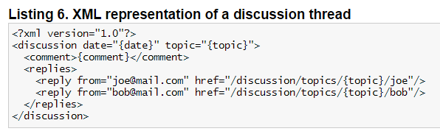
Transfer XML, JSON, or both
A resource representation typically reflects the current state of a resource, and its attributes, at the time a client application requests it.
In which format to serve the data? What about presentational artifacts?

Slide 13
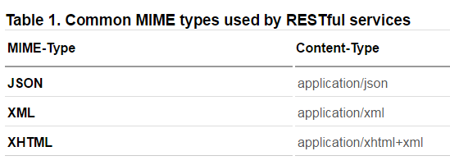
Transfer XML, JSON, or both
Let the client application choose the content type that is best suited for them
Construct your service so that it makes use of the built-in HTTP Accept header, where the value of the header is a MIME type.

Slide 14
References
https://www.ibm.com/developerworks/library/ws-restful/

